Slide 1



LOOKER TRAINING FOR BEGINNERS
By Devarajan Palaniappan (DATA POLE)
Session 4

Slide 2
Overview of Visualization Visualization Settings Looks Overview of Dashboard Looker Marketplace Types Of Data Visualizations
Table of Contents

Slide 3
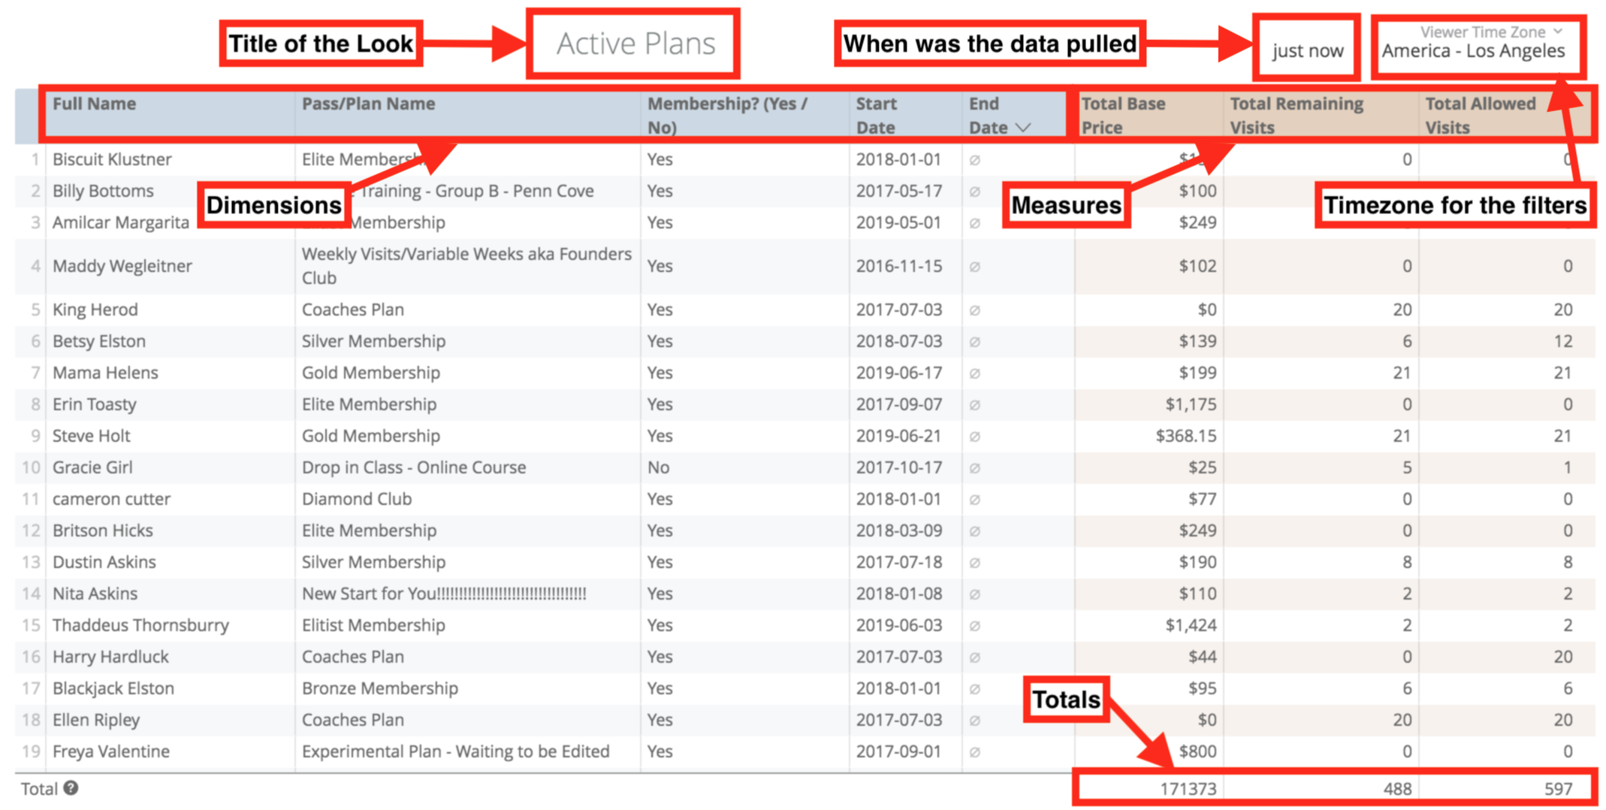
Visualization Section From Explore UI

Slide 4
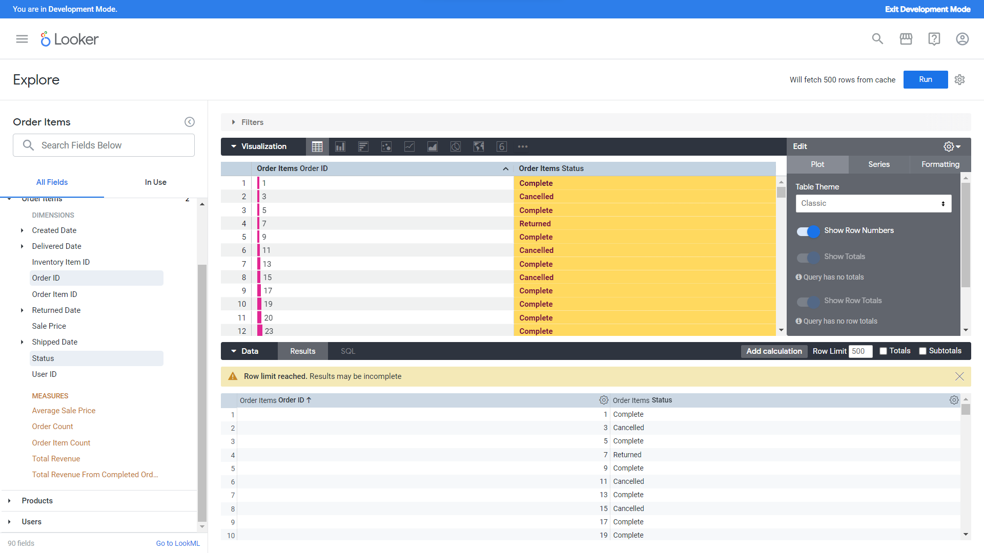



Slide 5
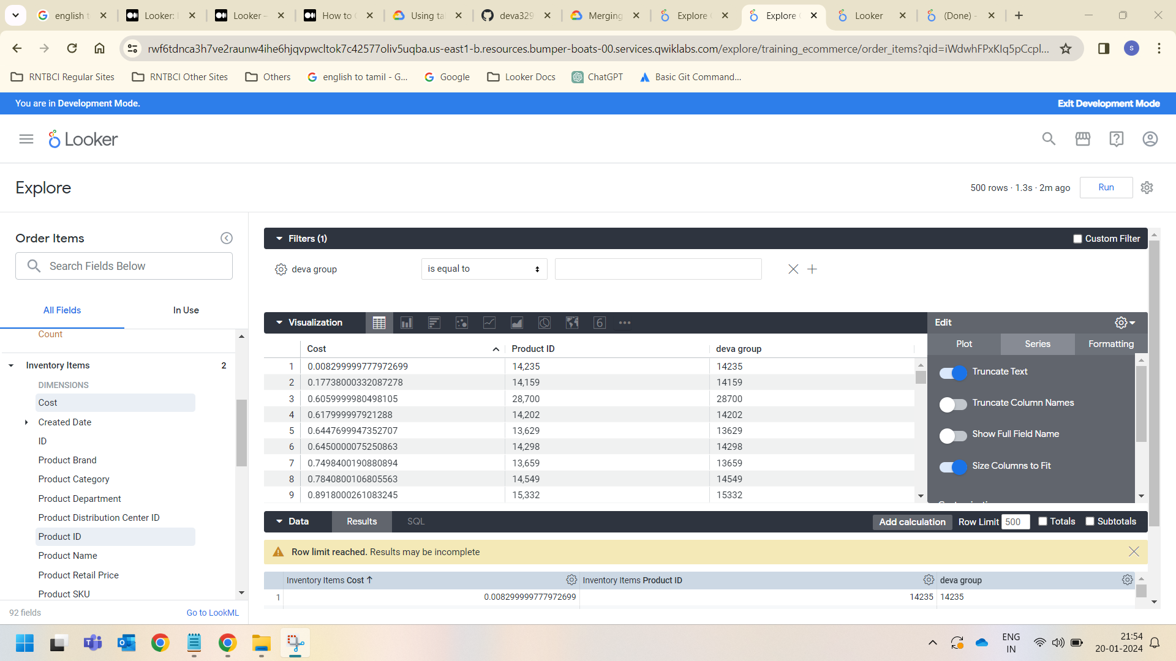


Slide 6
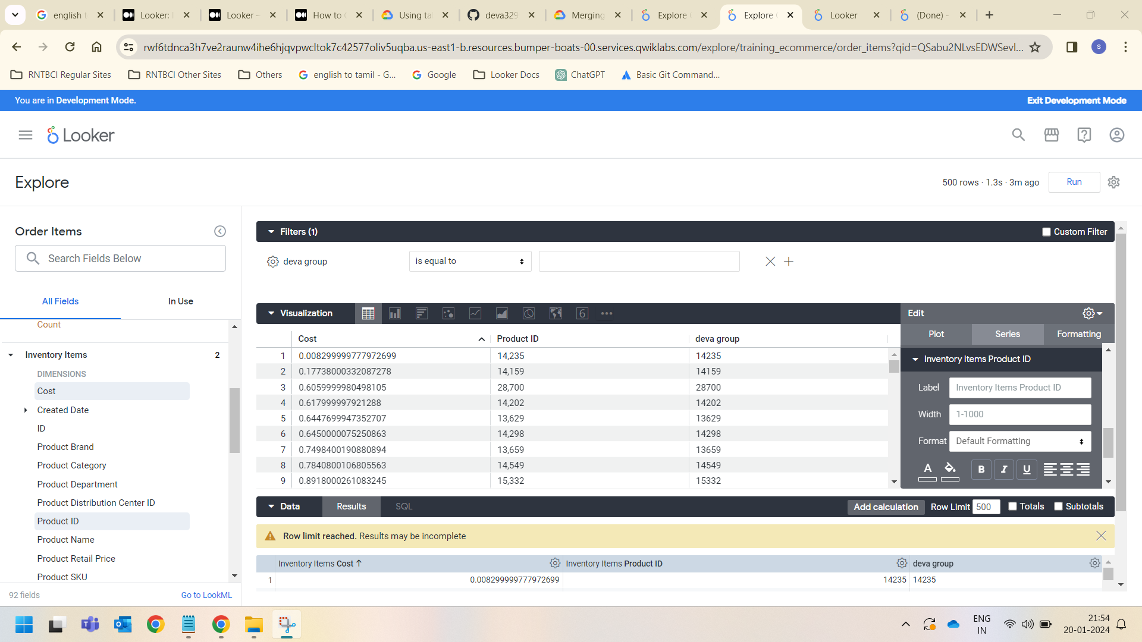

Slide 7
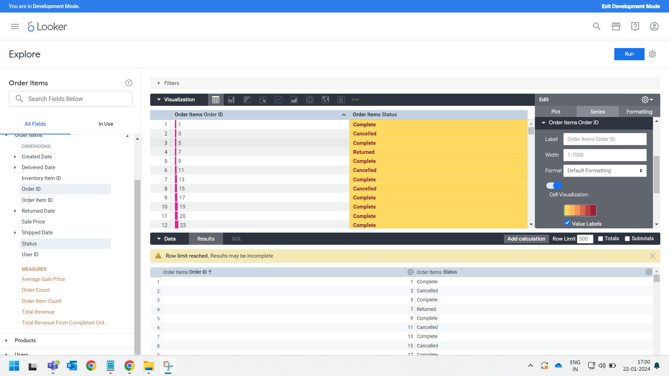


Slide 8
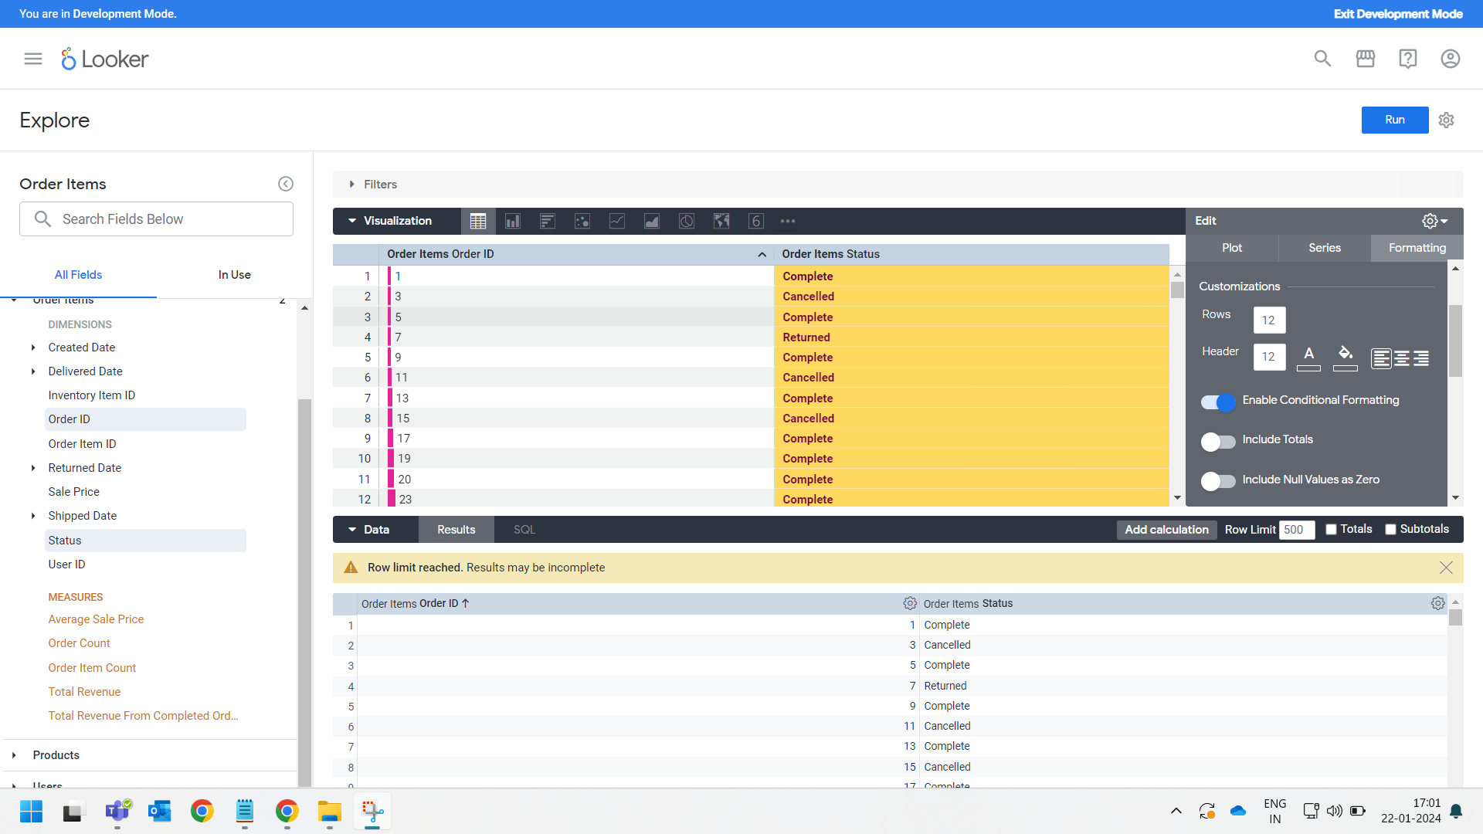



Slide 9
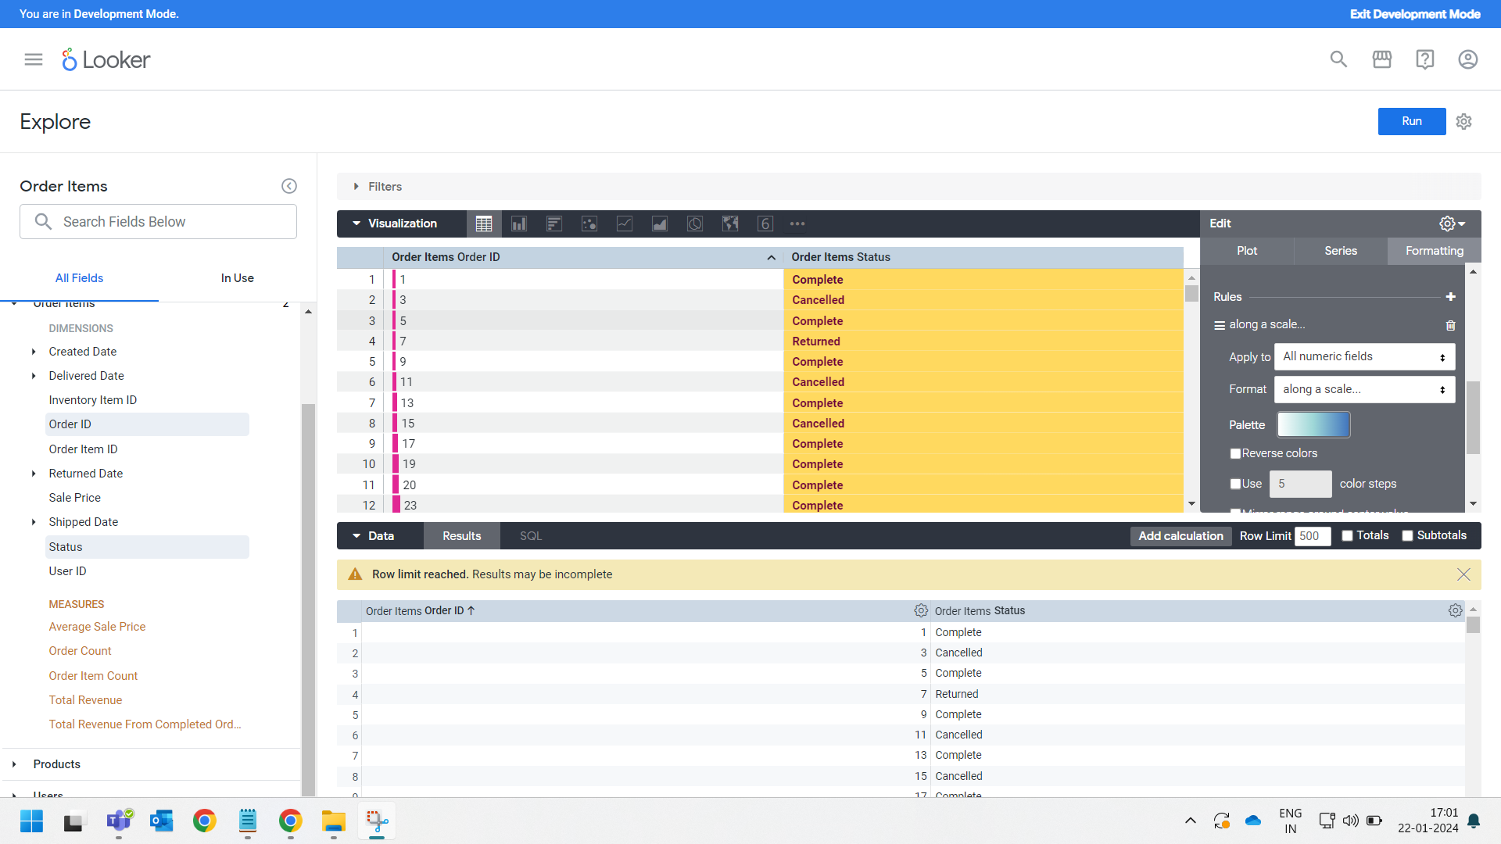

Slide 10
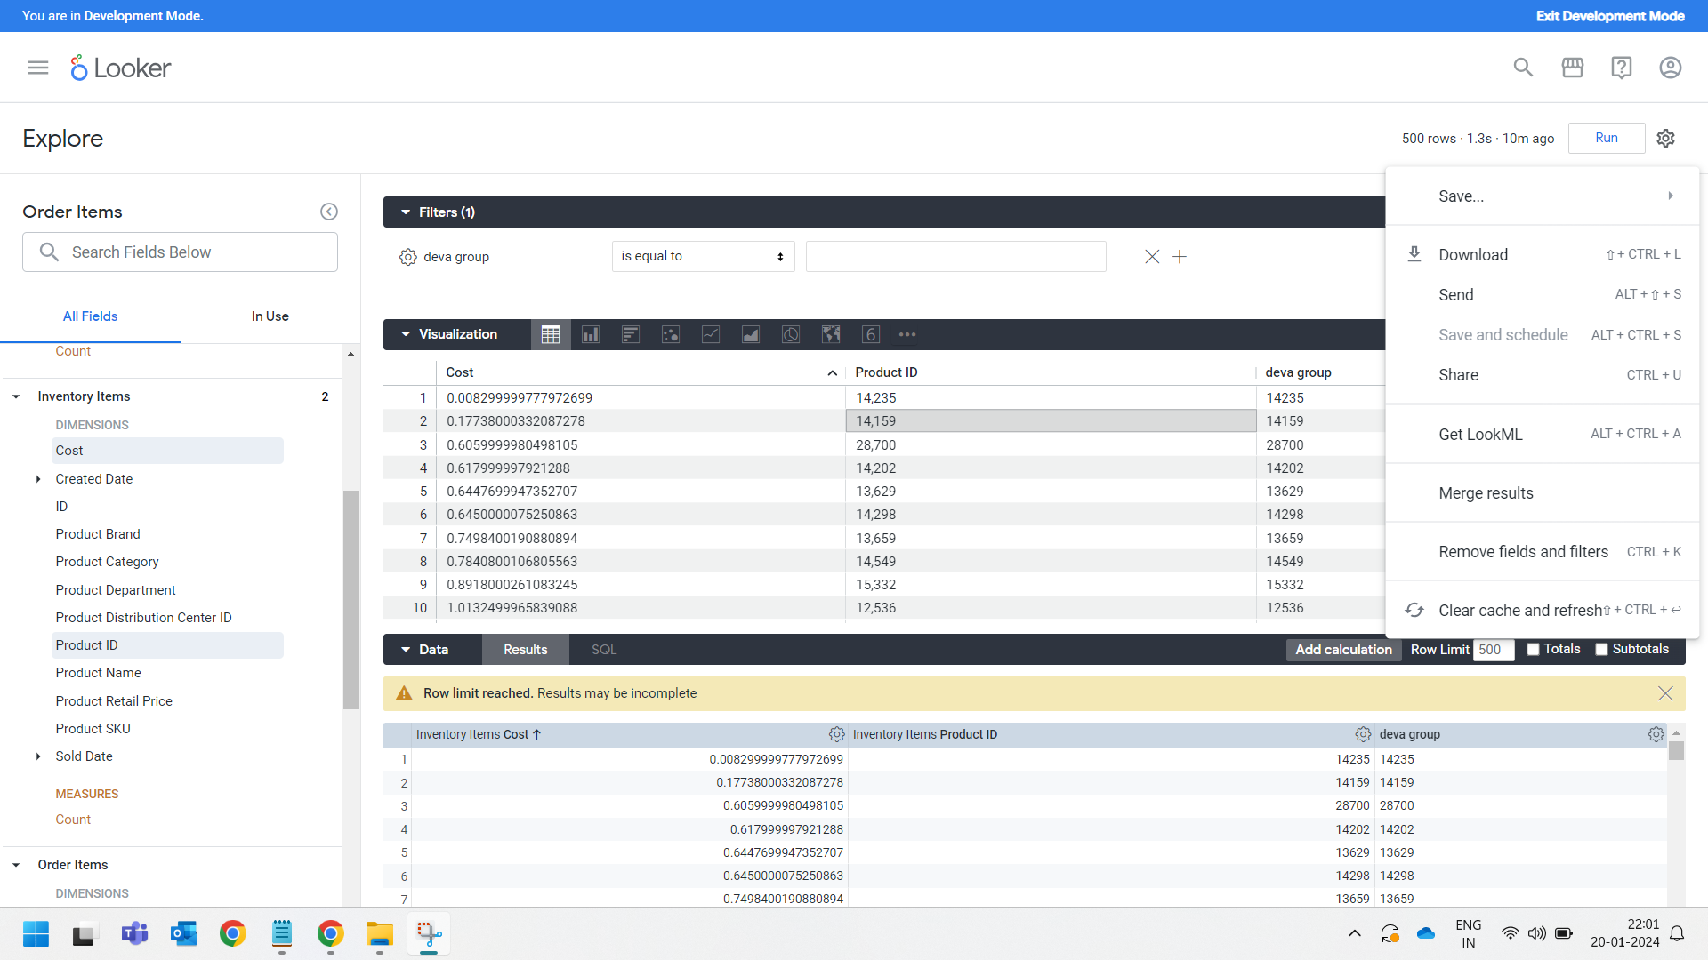



Slide 11
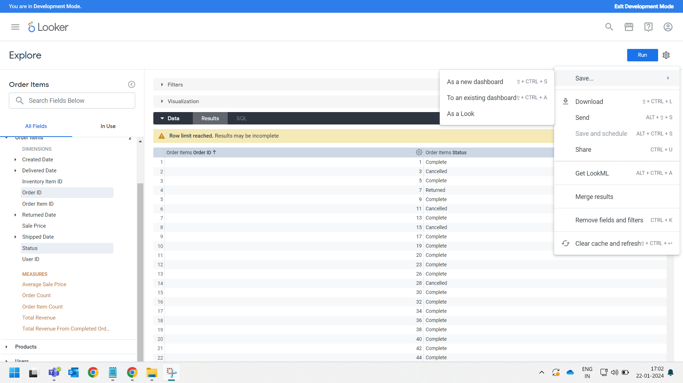



Slide 12
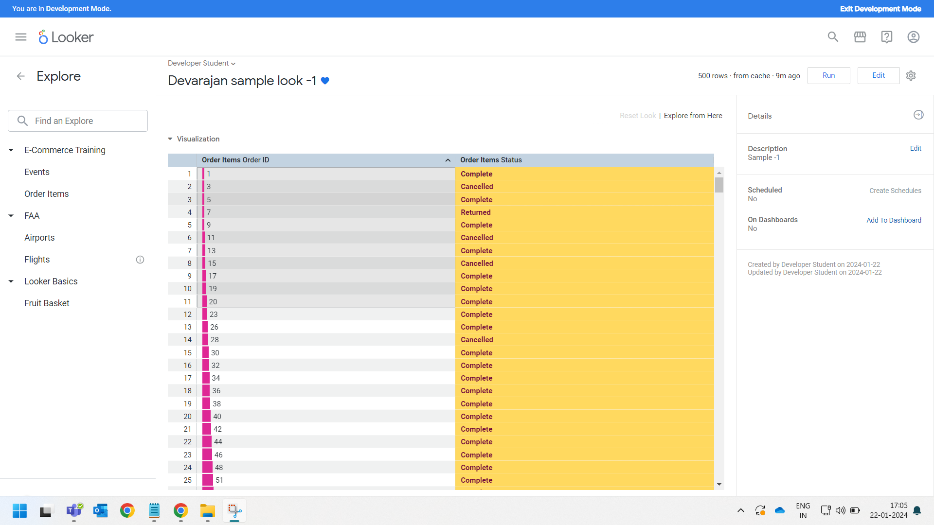

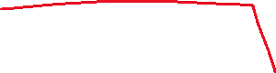


Slide 13
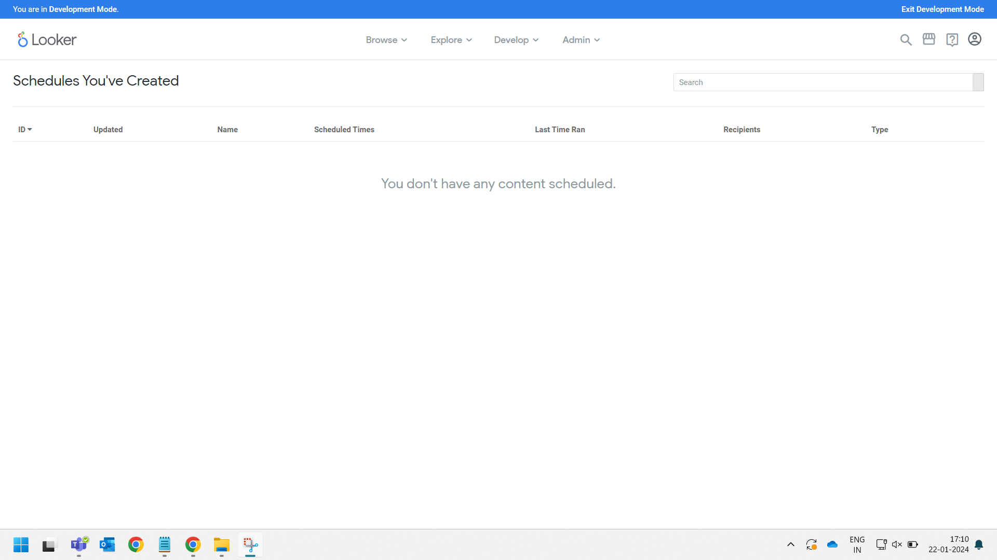




Slide 14
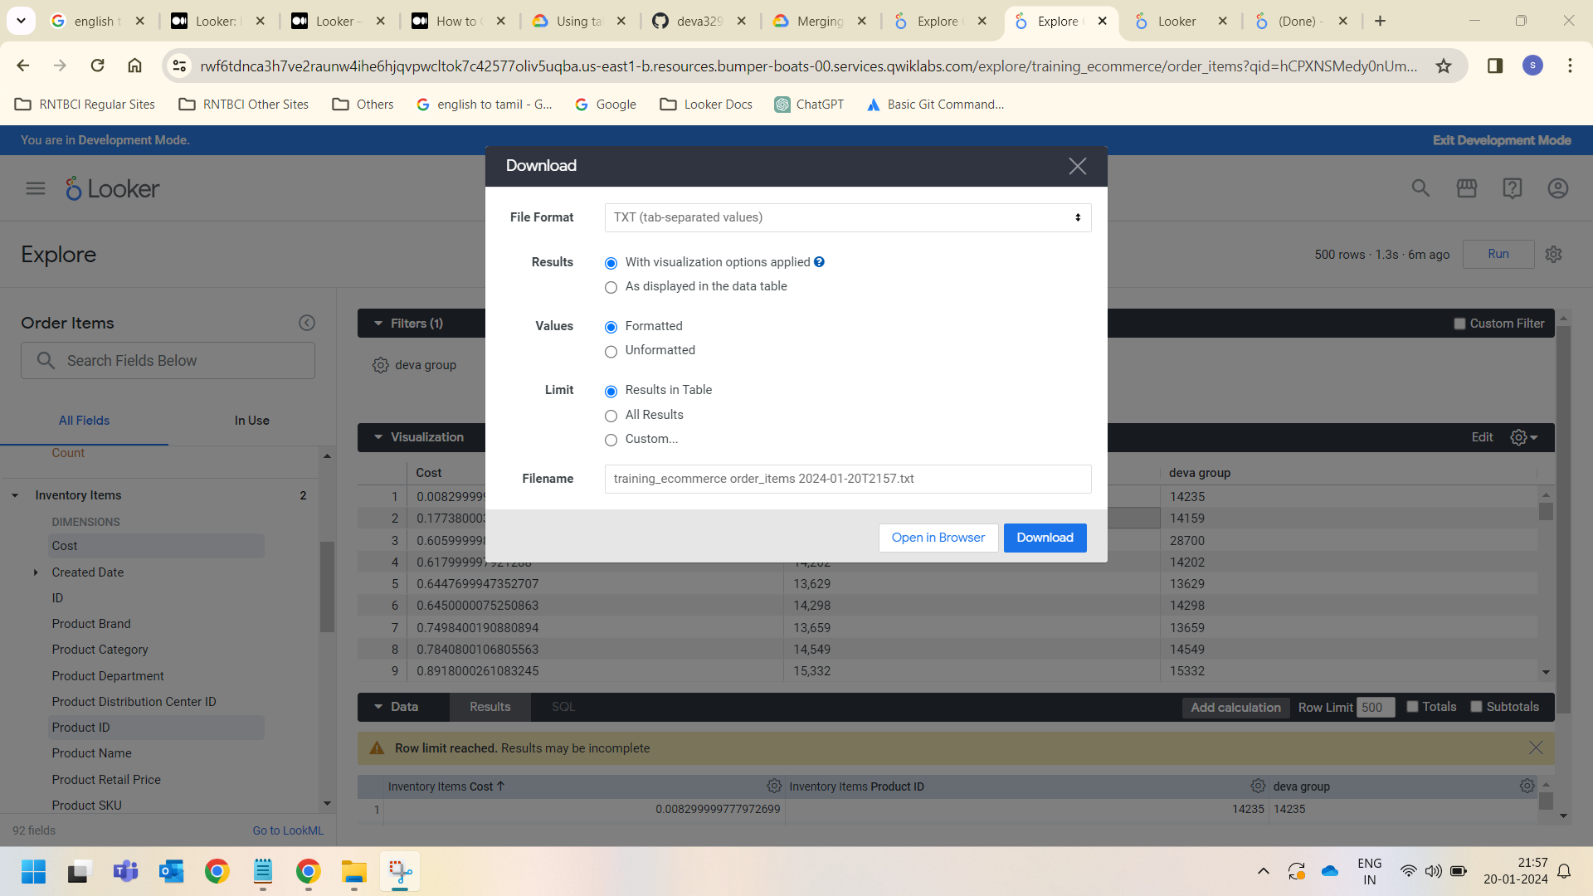





Slide 15
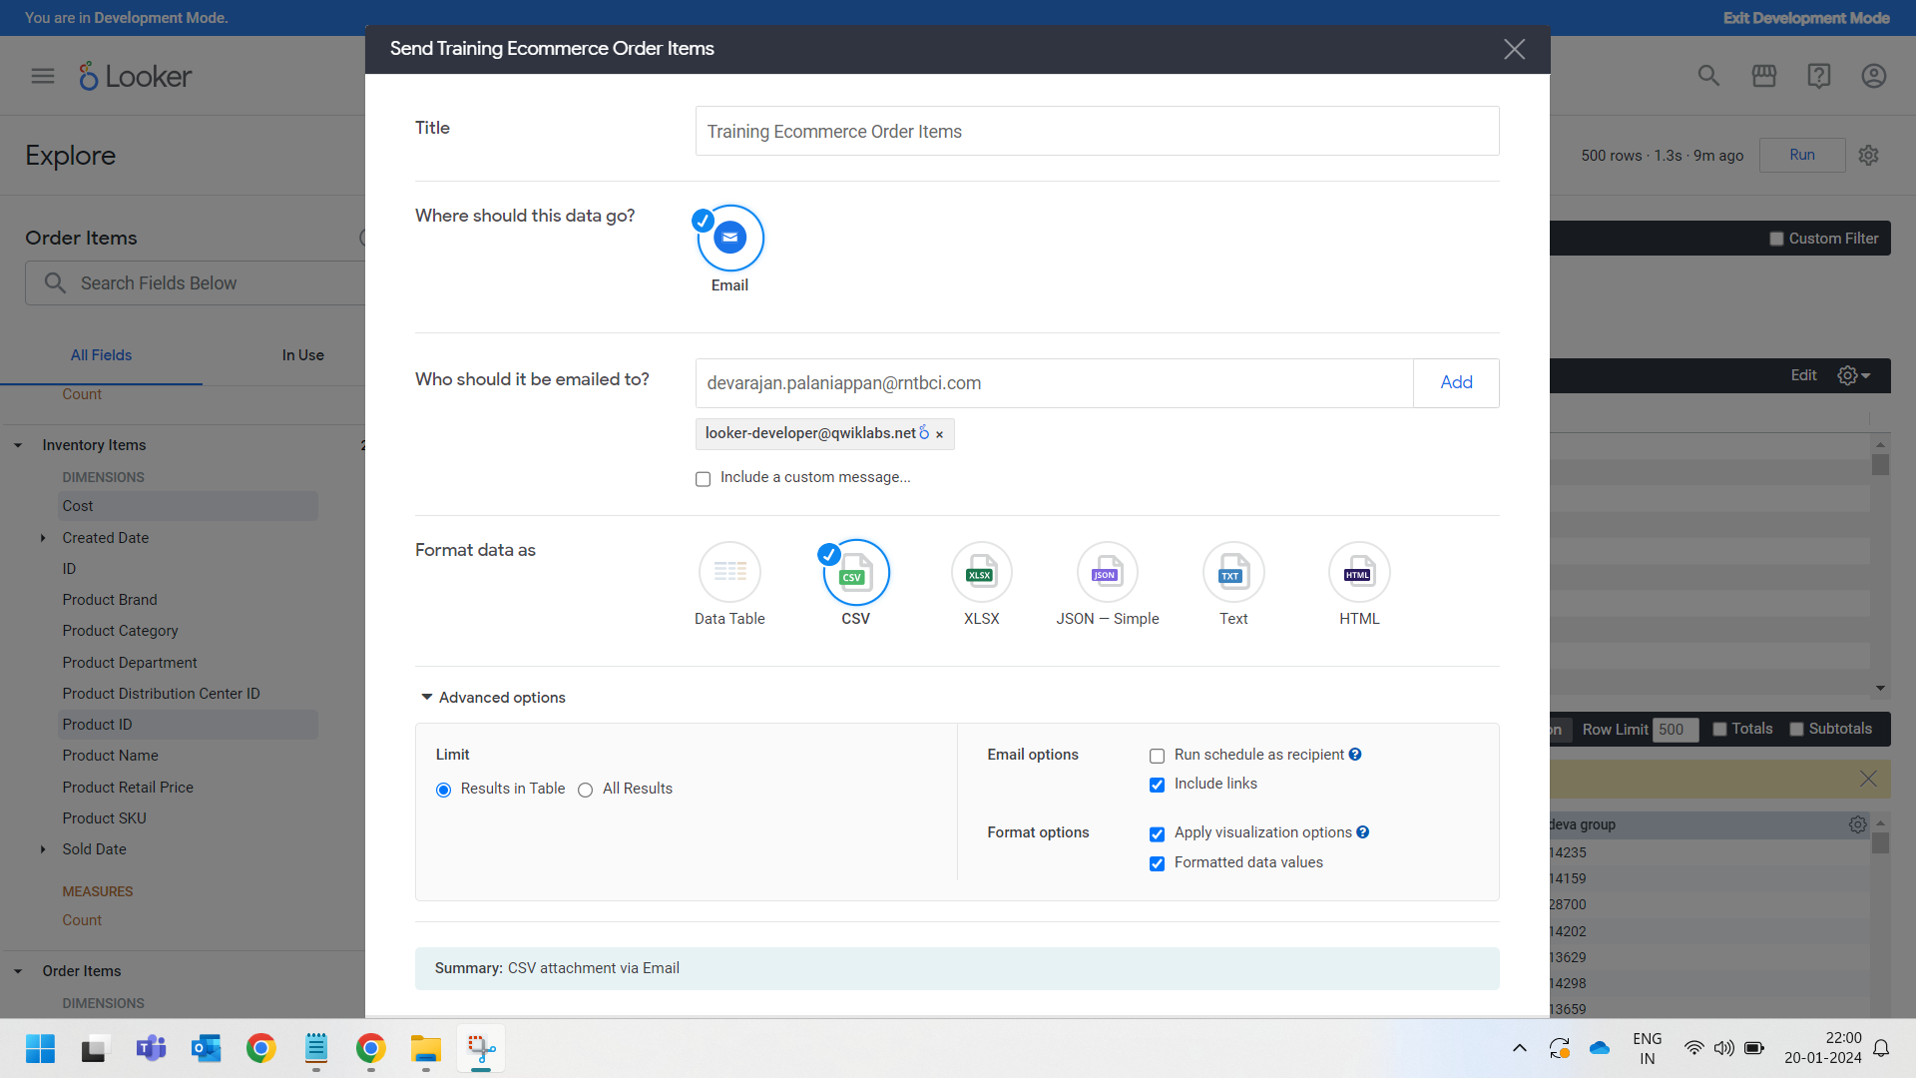





Slide 16
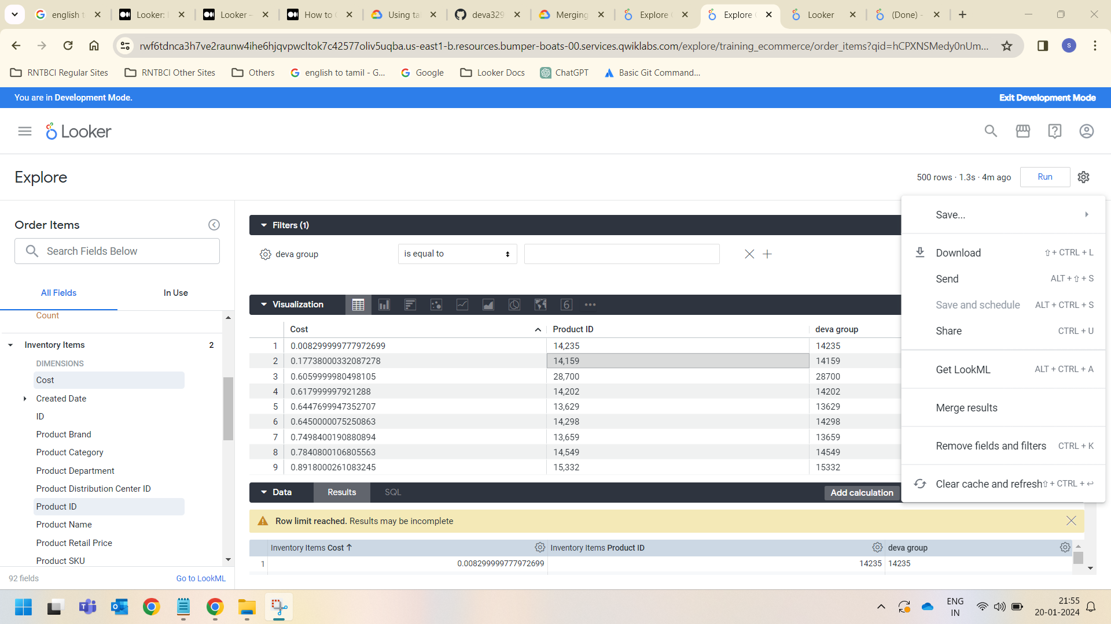





Slide 17
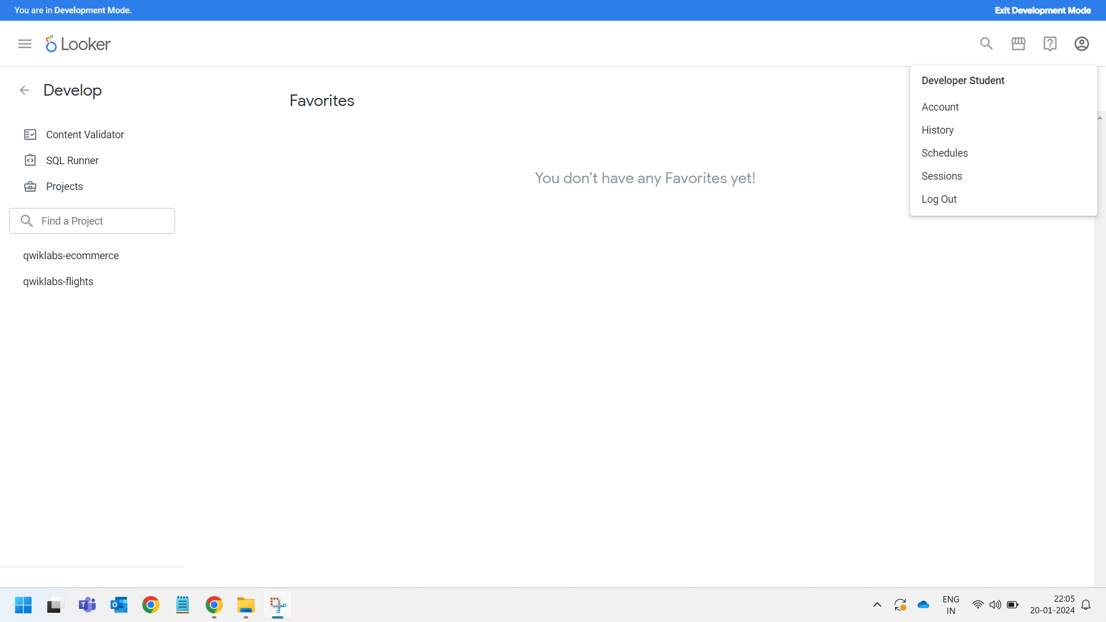













Slide 18
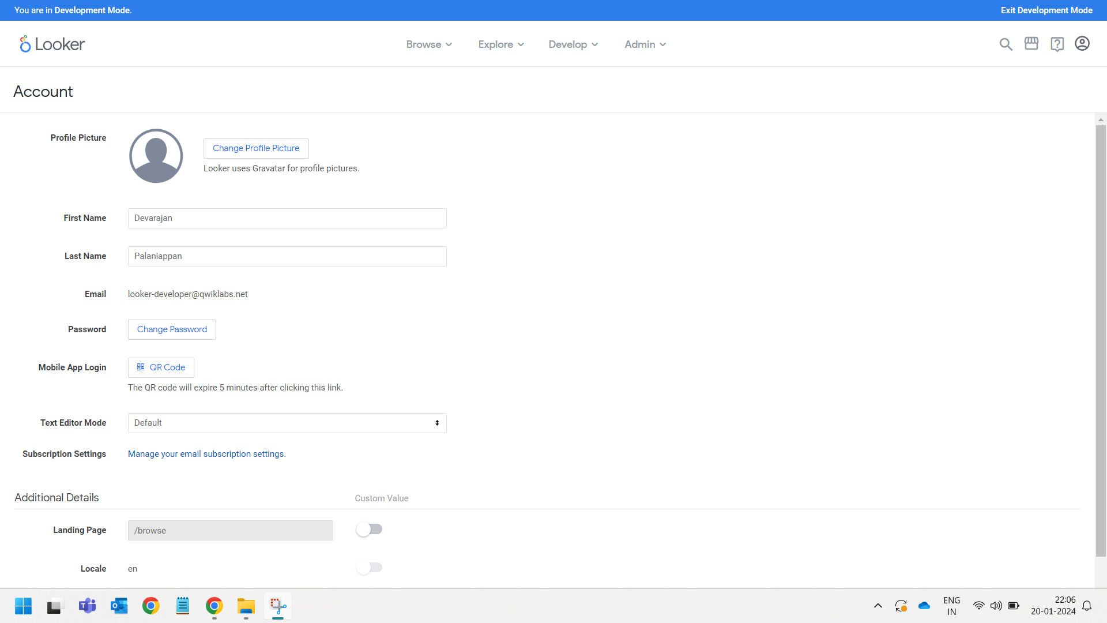










These Account settings are only working in Paid version instead of trial version it is not working

Slide 19
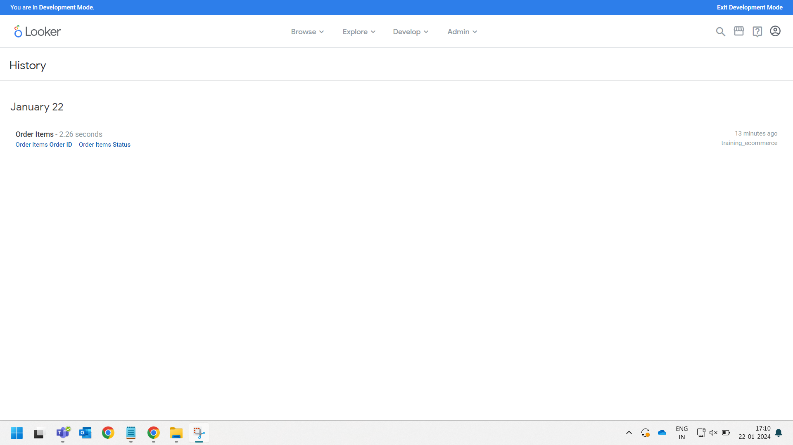



Slide 20
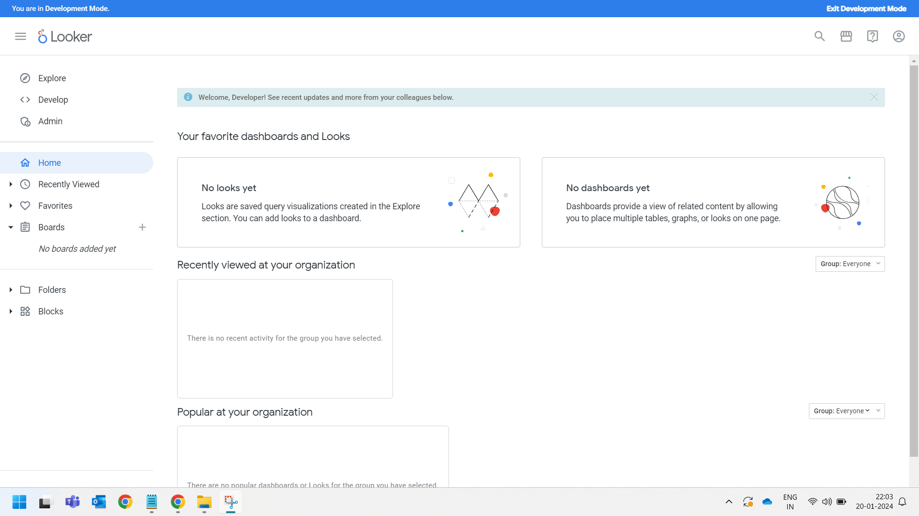




Slide 21
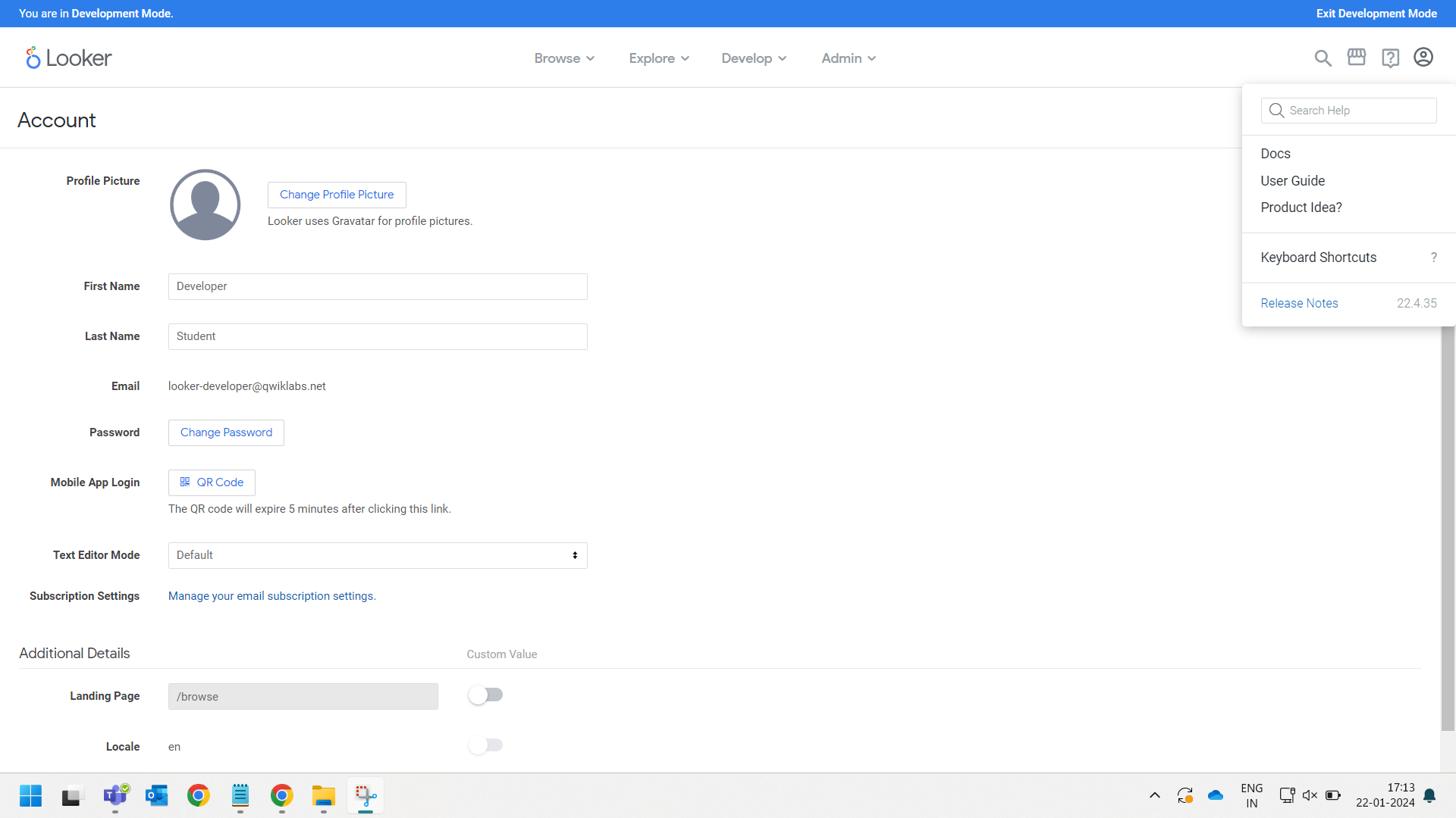









Slide 22
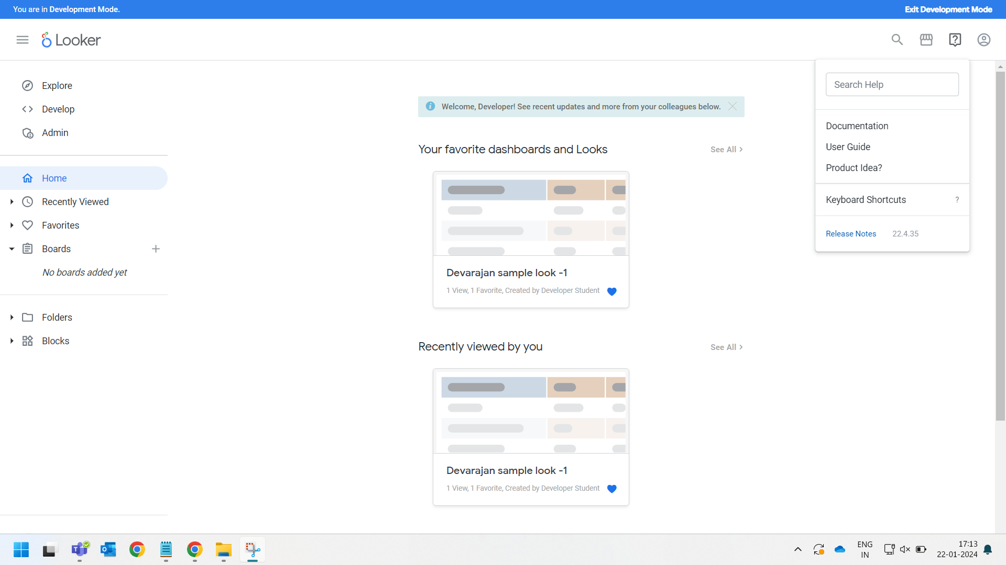







Slide 23
Types Of Data Visualizations In Looker

Slide 24
Visualization types
Looker has many visualizations that you can use to make sense of your data. Each type of visualization has different settings that you can use to customize its appearance. The following links provide information about each visualization and its settings.
Cartesian charts
Column
Bar
Scatterplot
Line
Area
Boxplot
Waterfall
Pie and donut charts
Pie
Donut Multiples

Slide 25
Progression charts
Funnel
Timeline
Text and tables
Single Value
Single Record
Table
Table (Legacy)
Word Cloud
Maps
Google Maps
Map
Static Map (Regions)
Static Map (Points)

Slide 26
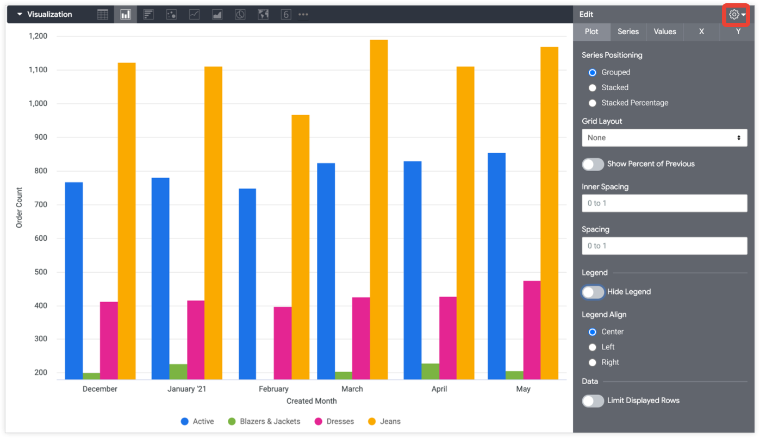
Column Chart Visualization:

Slide 27
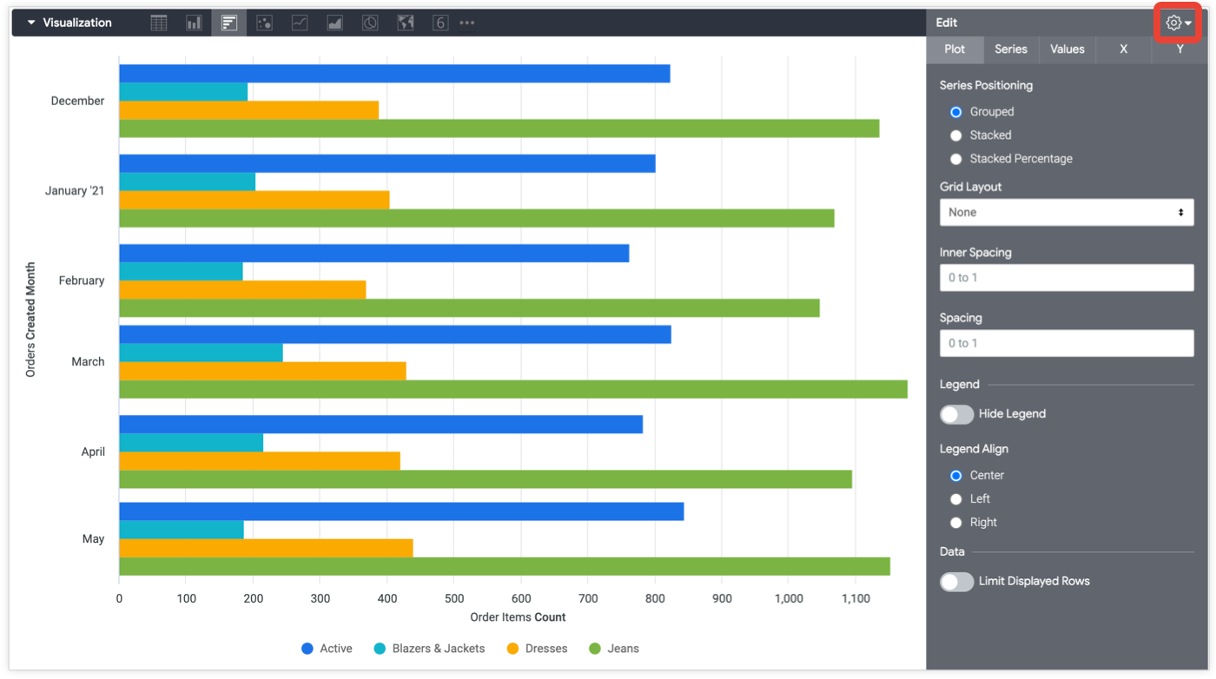
Bar Chart Visualization :

Slide 28
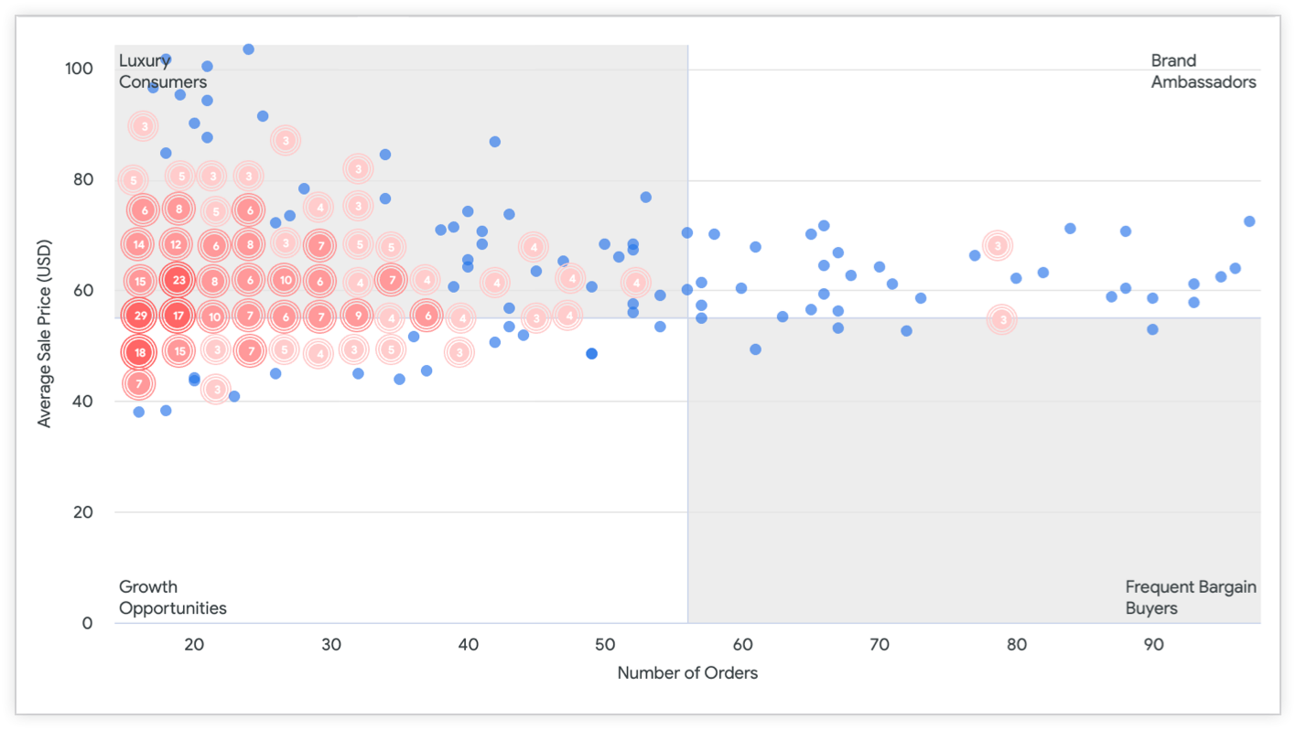
Scatterplot Chart Visualization :

Slide 29
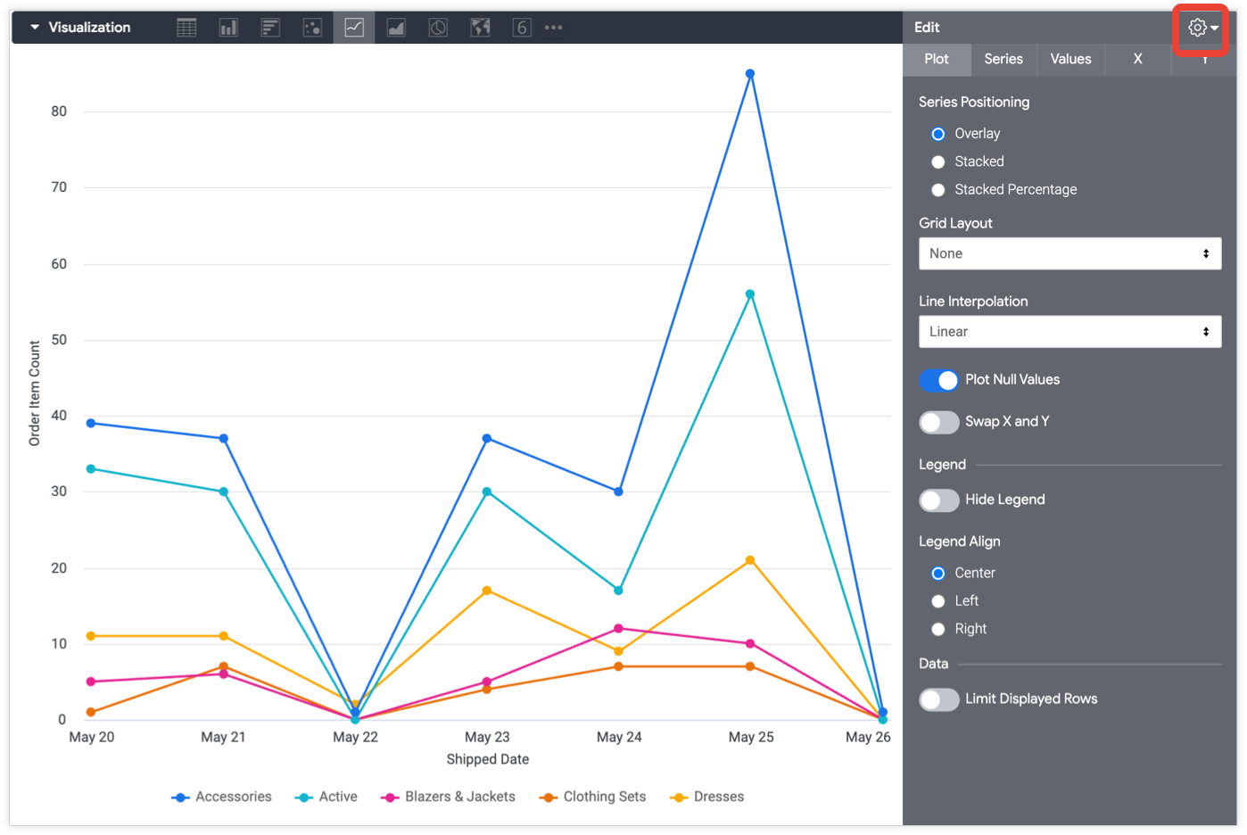
Line Chart Visualization :

Slide 30
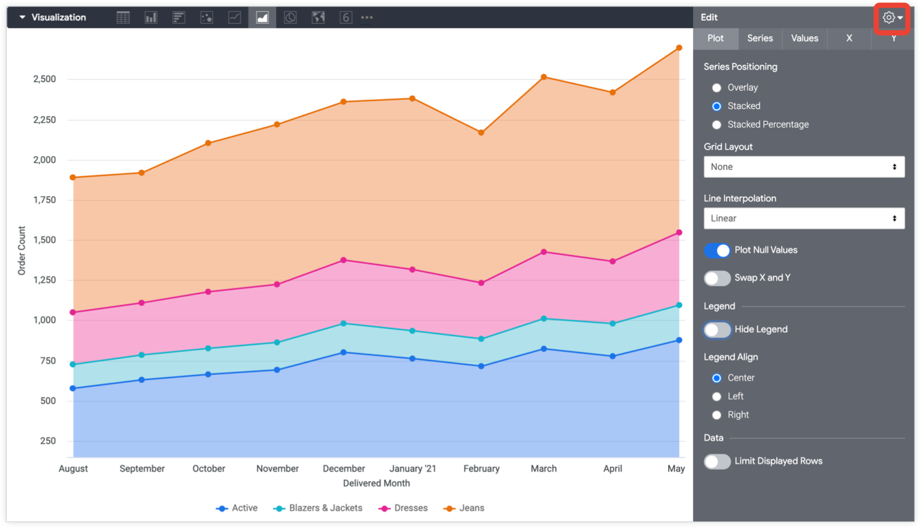
Area Chart Visualization :

Slide 31
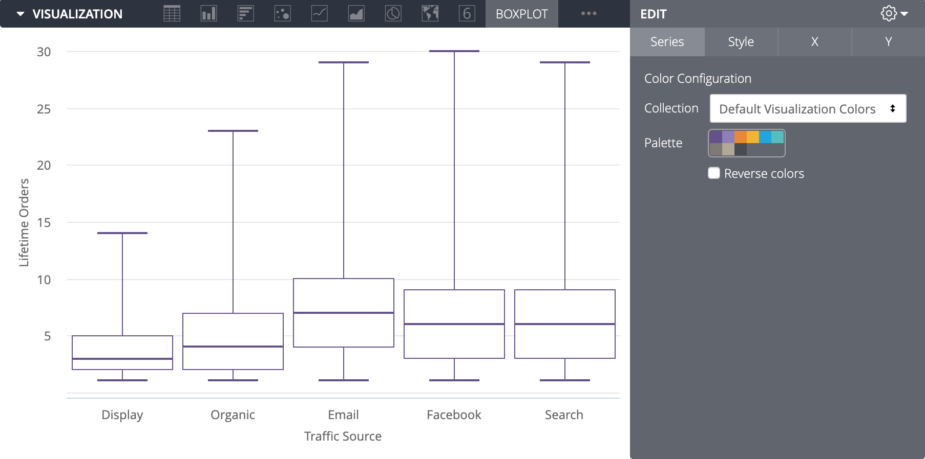
Boxplot Chart Visualization :

Slide 32
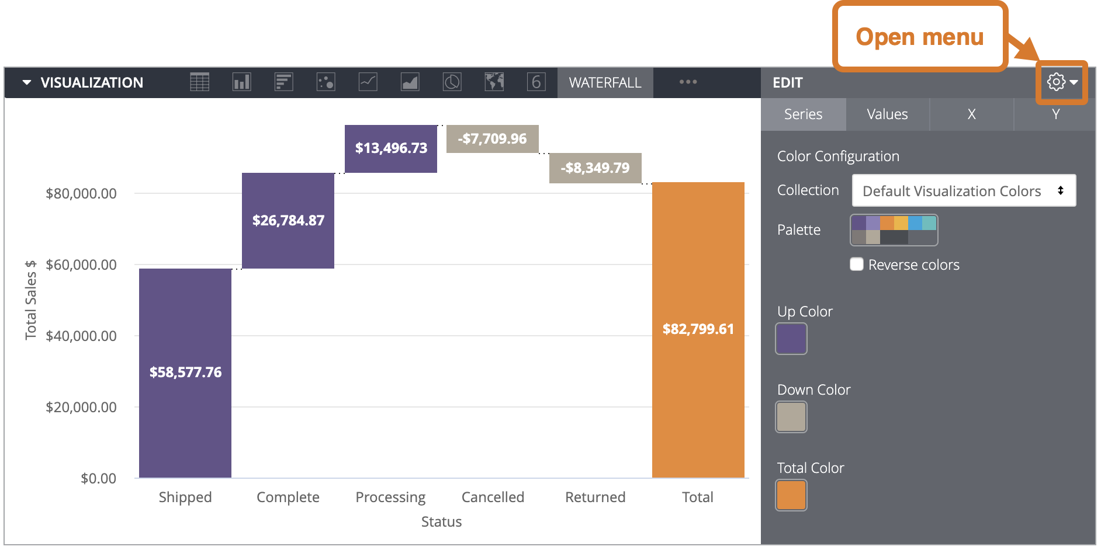
Waterfall Chart Visualization :

Slide 33
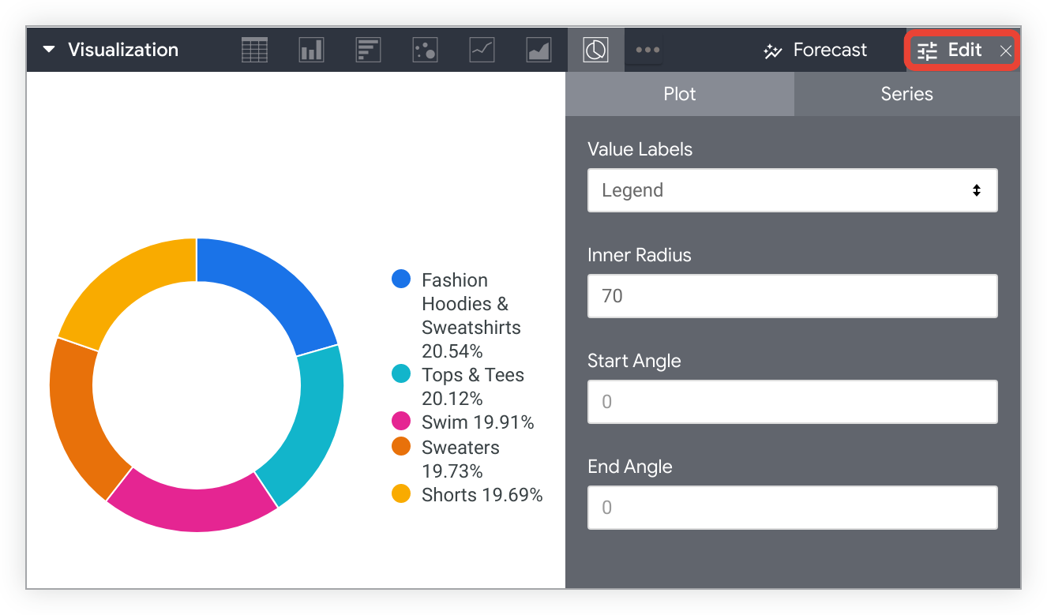
Pie Chart Visualization :

Slide 34
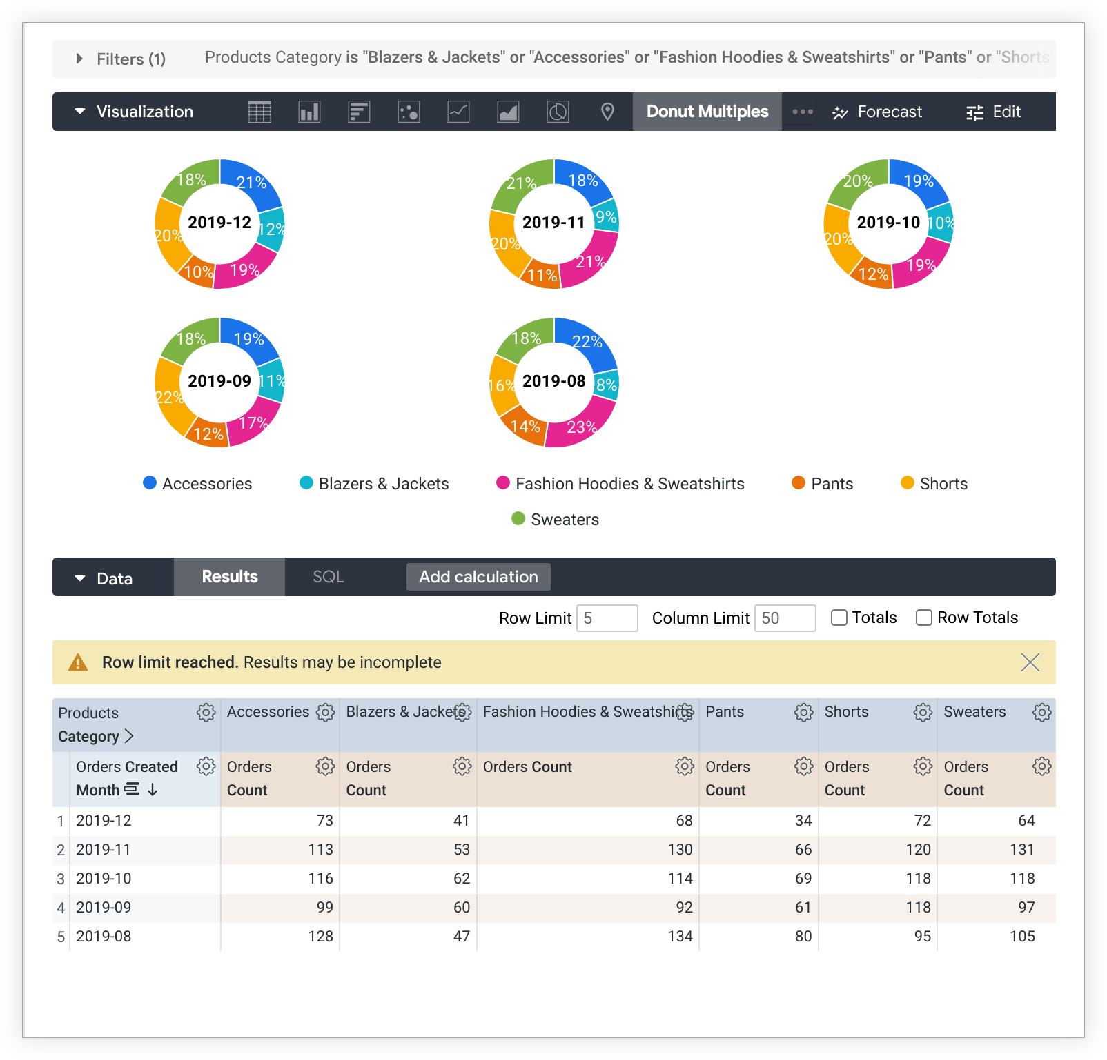
Donut multiples Chart Visualization :

Slide 35
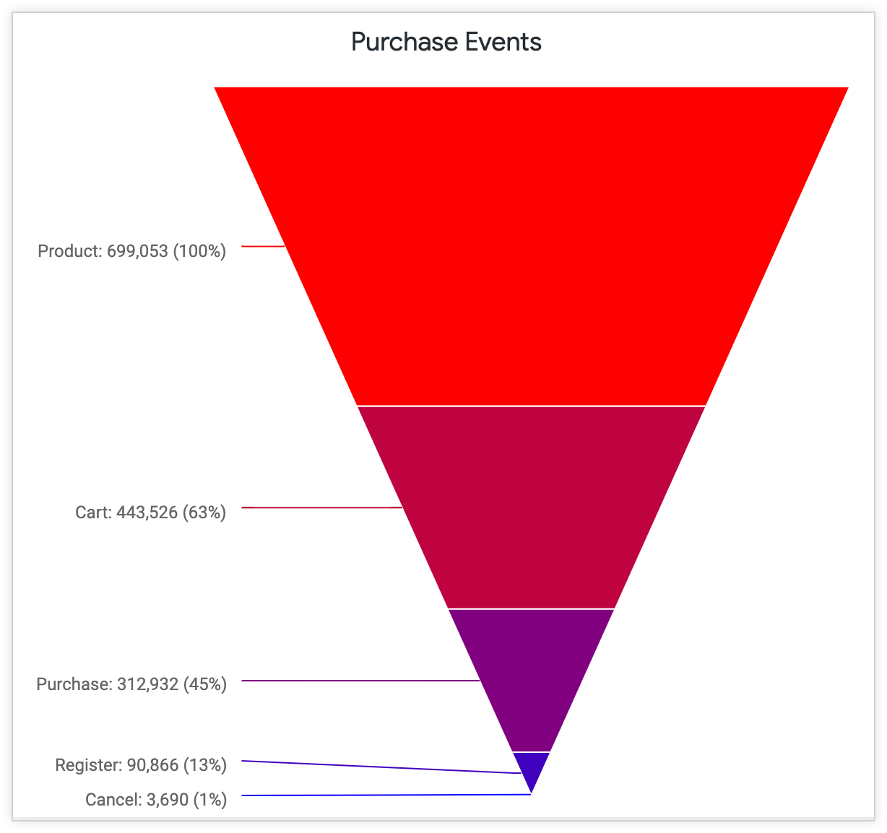
Funnel Chart Visualization :

Slide 36
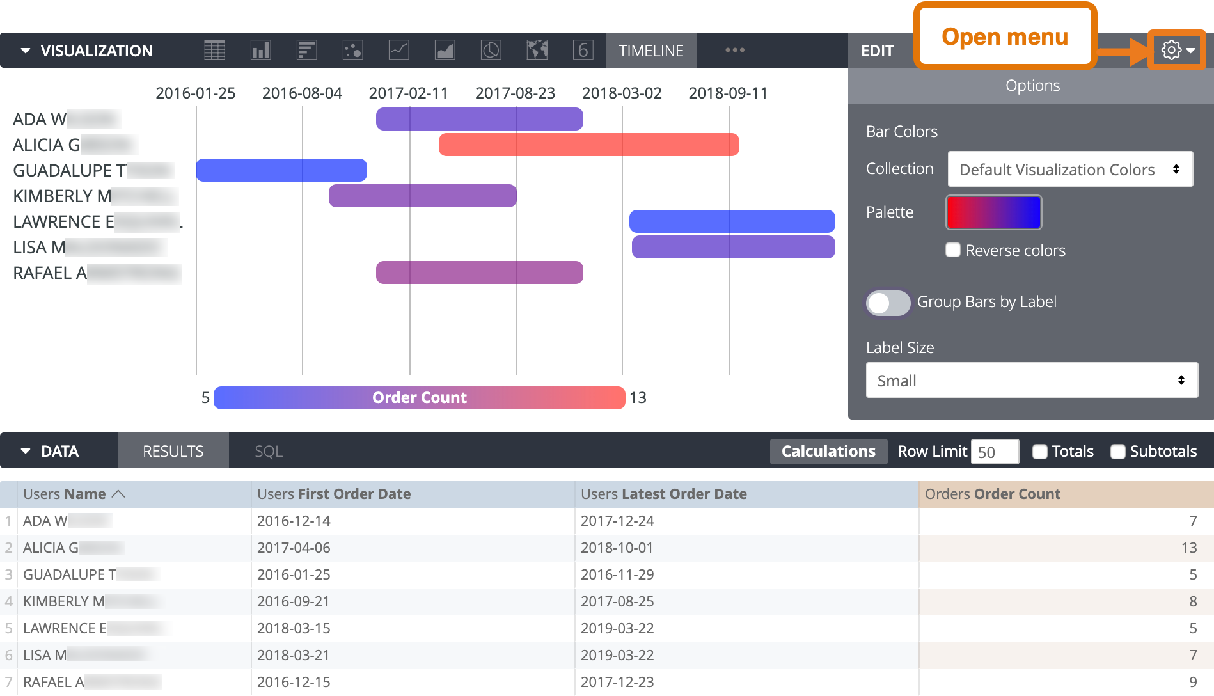
Timeline Chart Visualization :

Slide 37
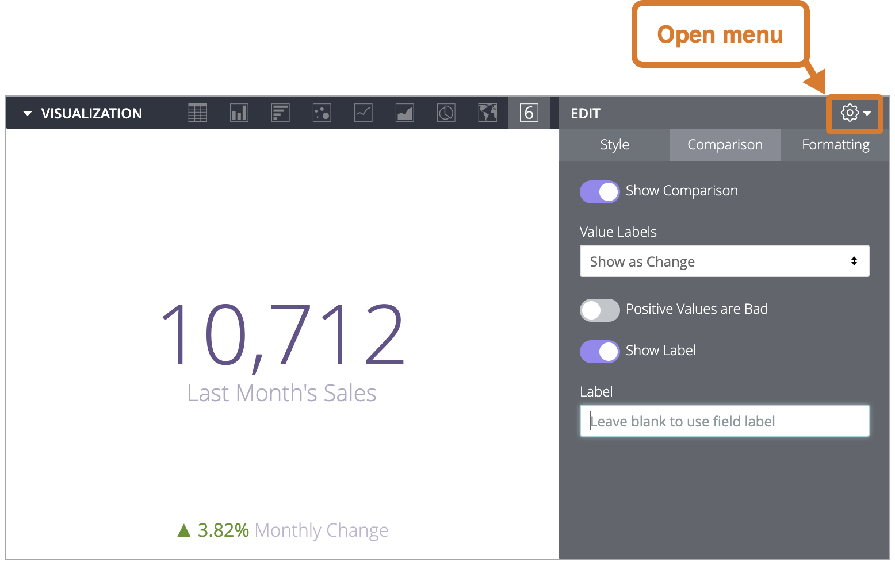
Single Value Chart Visualization :

Slide 38
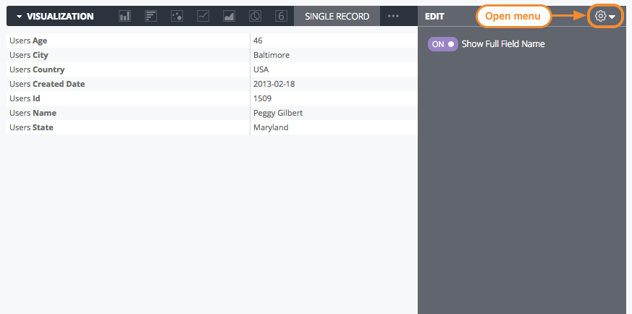
Single Record Chart Visualization :

Slide 39
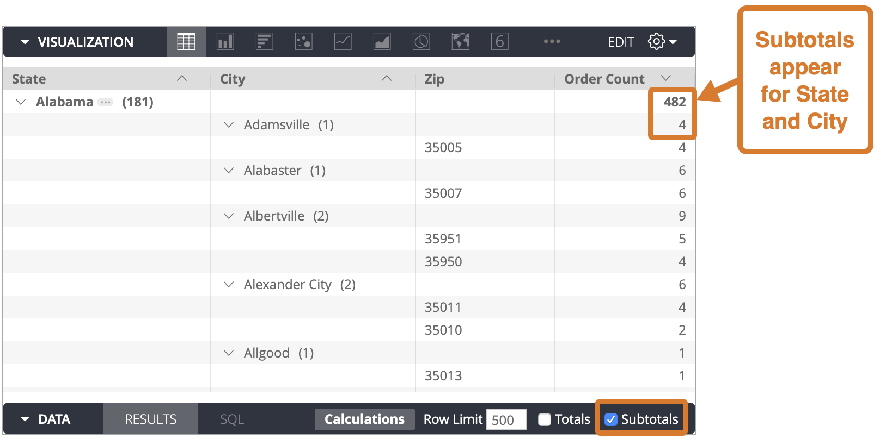
Table Chart Visualization :

Slide 40
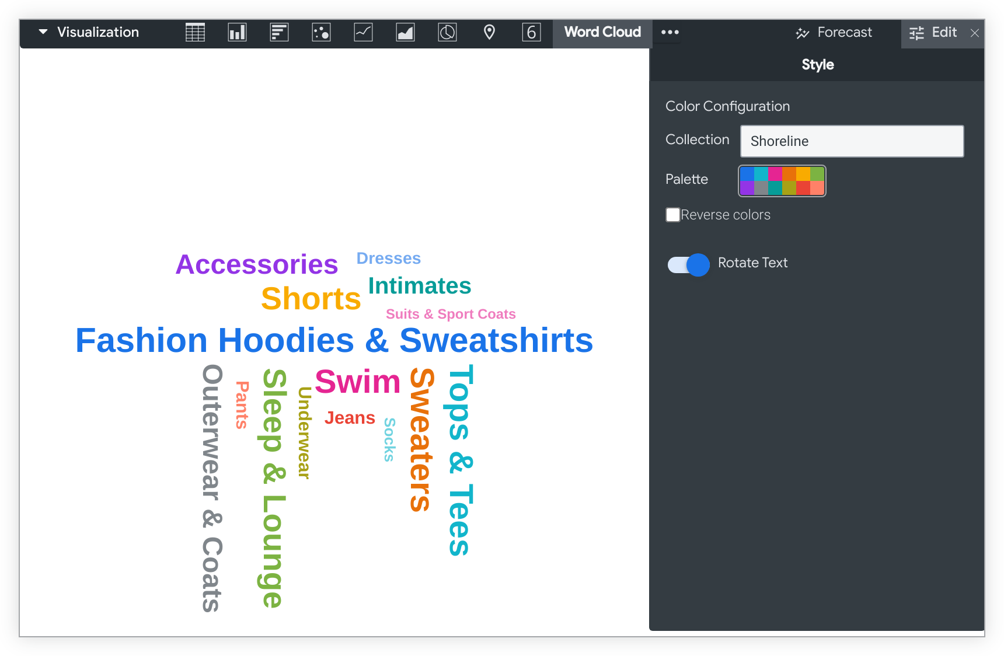
Word cloud Chart Visualization :

Slide 41
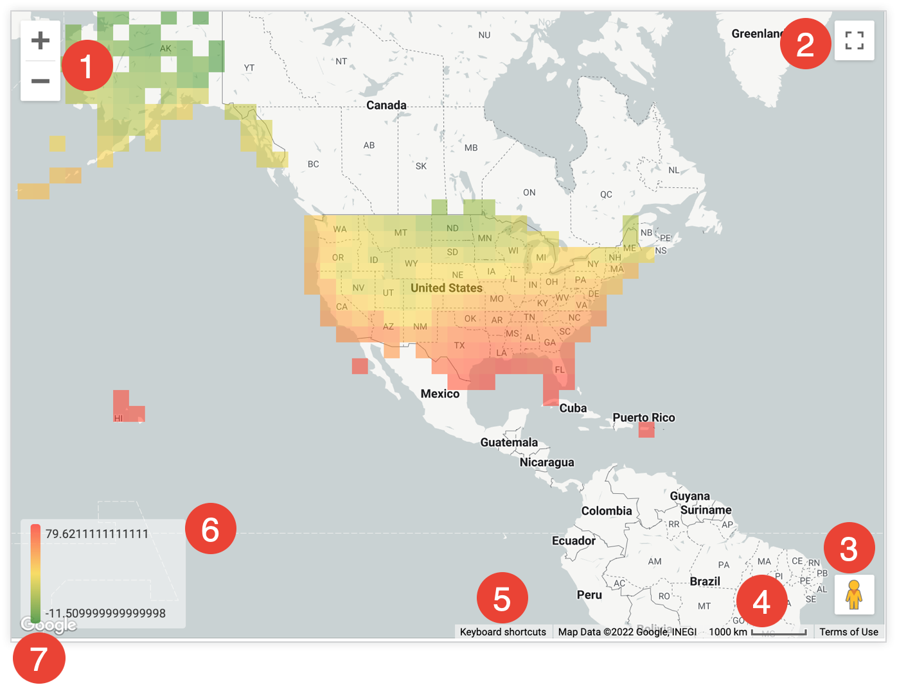
Google Maps Chart Visualization :

Slide 42
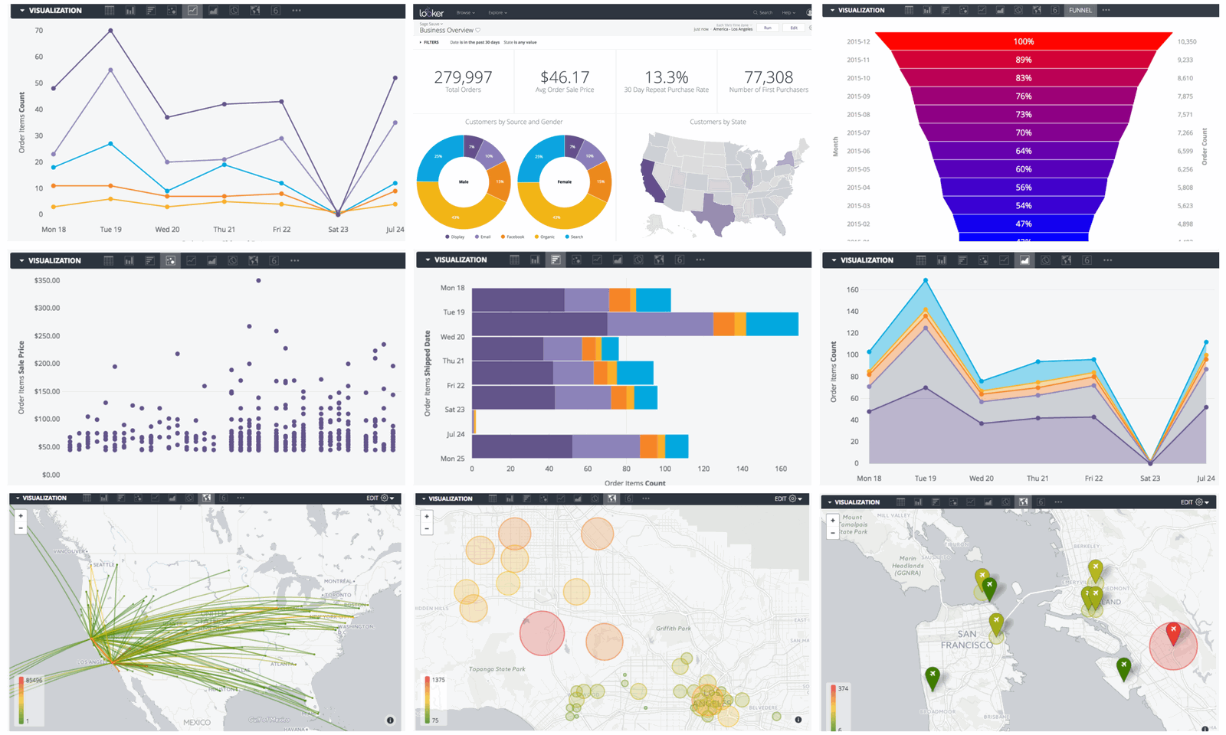

Slide 43
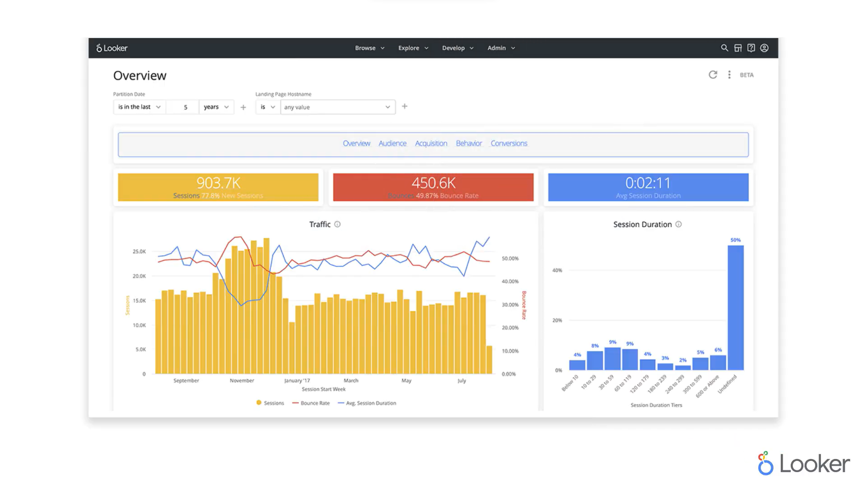

Slide 44
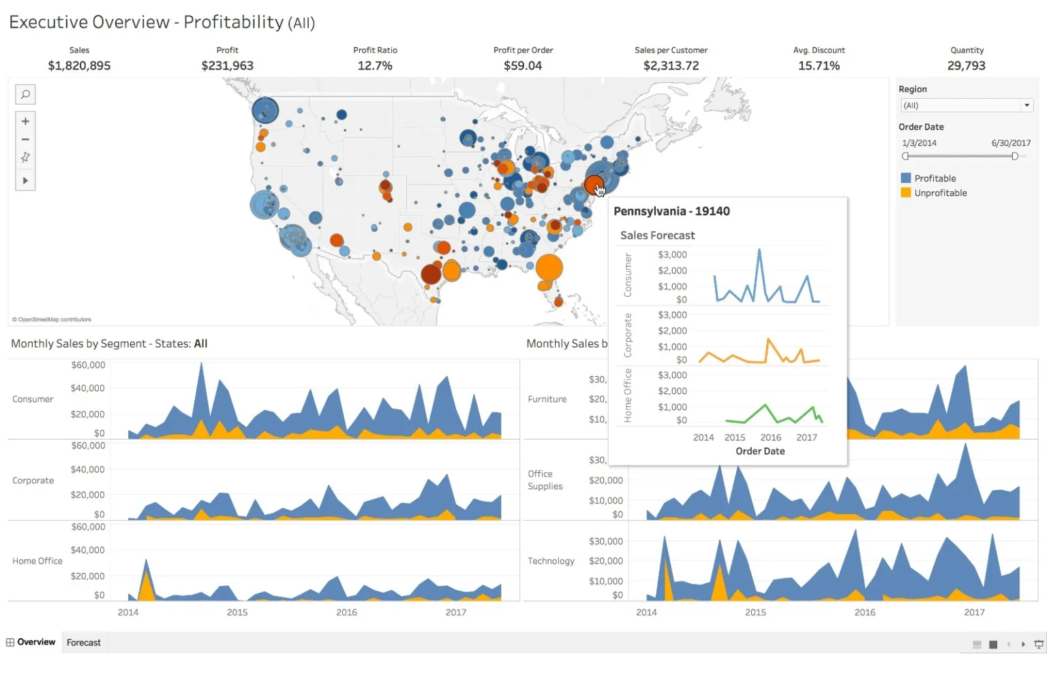

Slide 45
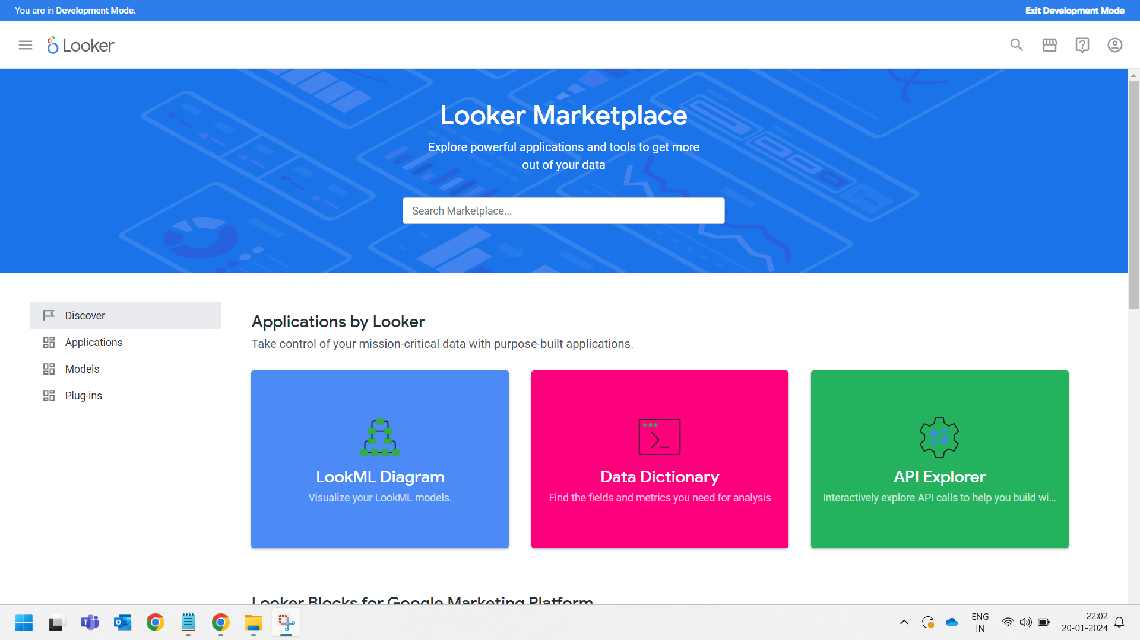

Slide 46
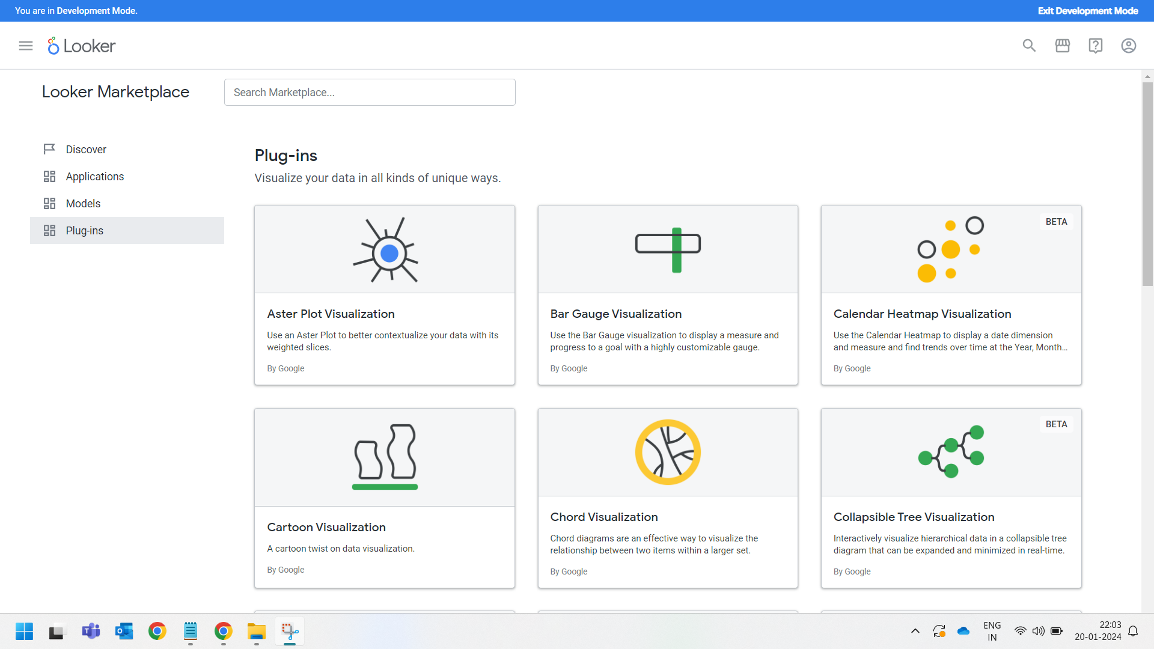

Slide 47
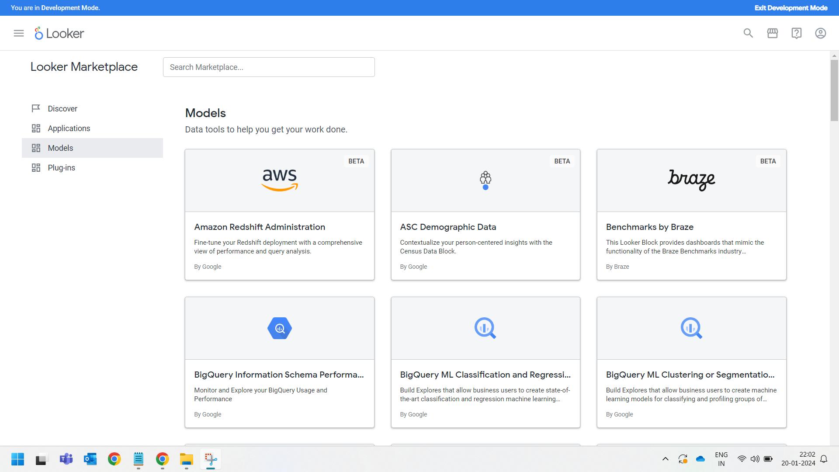

Slide 48
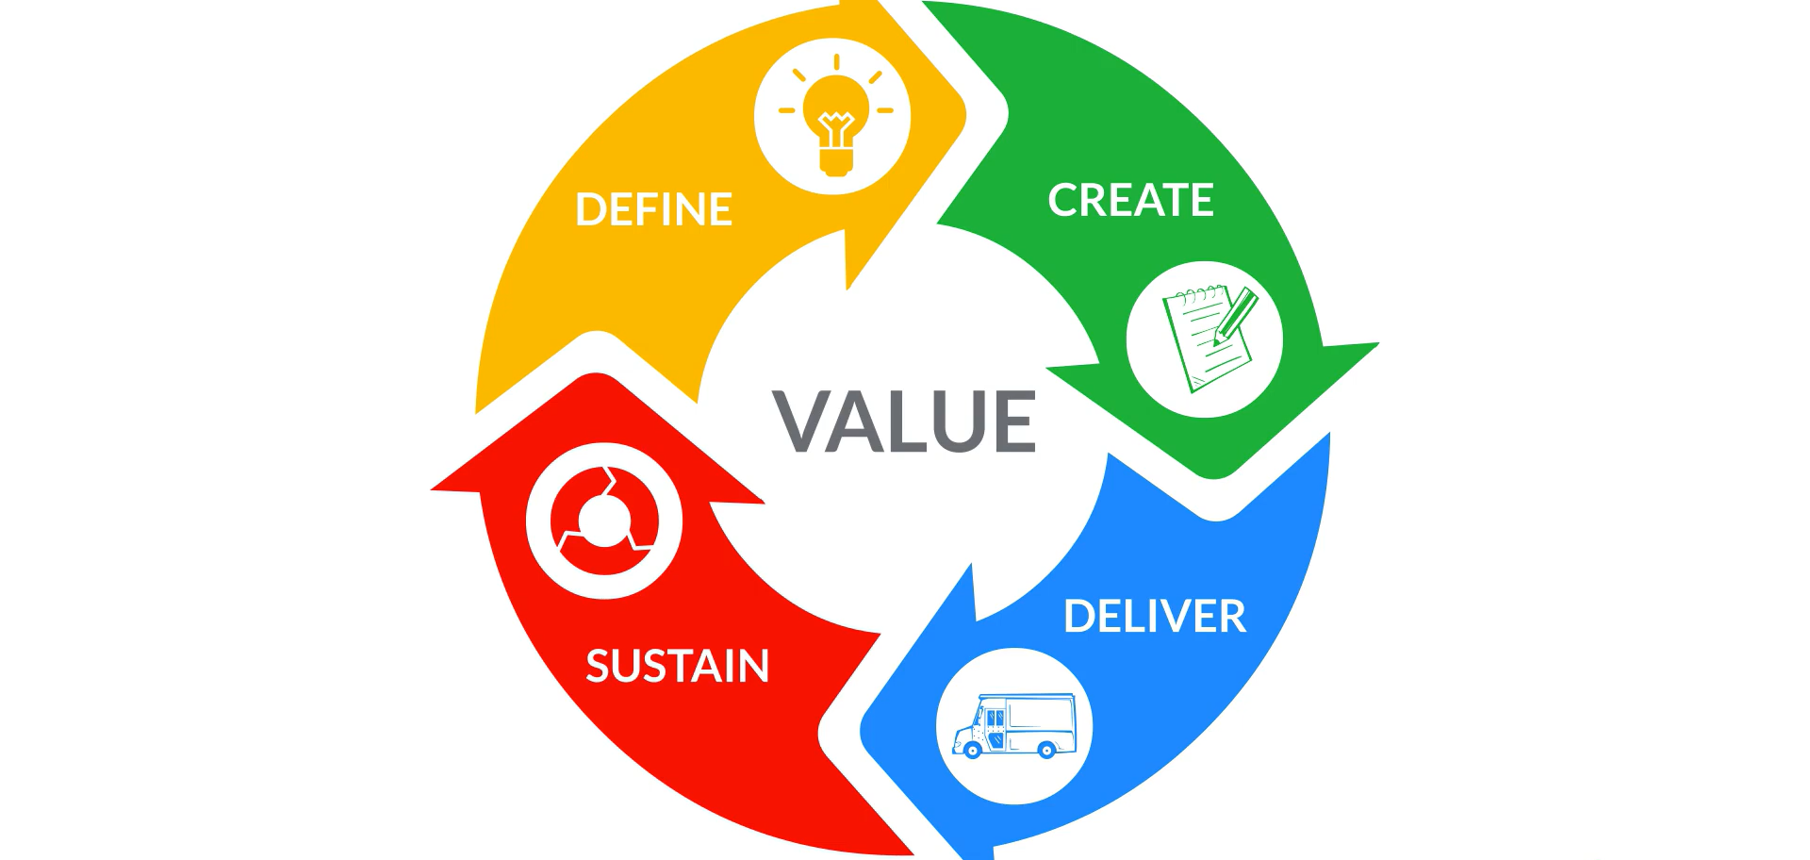

Slide 49


Slide 50


